Slide 1



Lecture Five( dispersion and prism )
Dr. Sabah Ibrahim Abbas Al-Karkh University
college of Sciences –Medical physics department

Slide 2
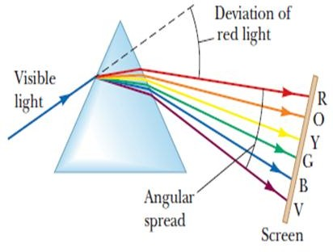
Lecture Five( dispersion and prism )

Slide 3



Lecture Five( dispersion and prism )
Prism:-
Is a transparent optical object with flat , polished surfaces that refract light . at least two of the flat surfaces must have an angle between them.
Bending of light:-
Ligth changes its speed when it moves from one medium to another . this speed change causes the light to be refracted and to enter the new medium at a different angle. The degree of bending of the light’s path depends on the angle that the incident ray of the light makes with the surface , and on the ratio between the refractive index of the two media.

Slide 4

Lecture Five( dispersion and prism )
Ray angle deviation and dispersion through a prism can be determined by tracing a sample ray through the element and using snell’s law at each interface. We'll express the emergent angle 𝑖₂ and the deviation angle δ as functions of the incident angle 𝑖₁ and after this we'll find the condition that minimizes the deviation angle 𝛿 as shown in figure.

Slide 5
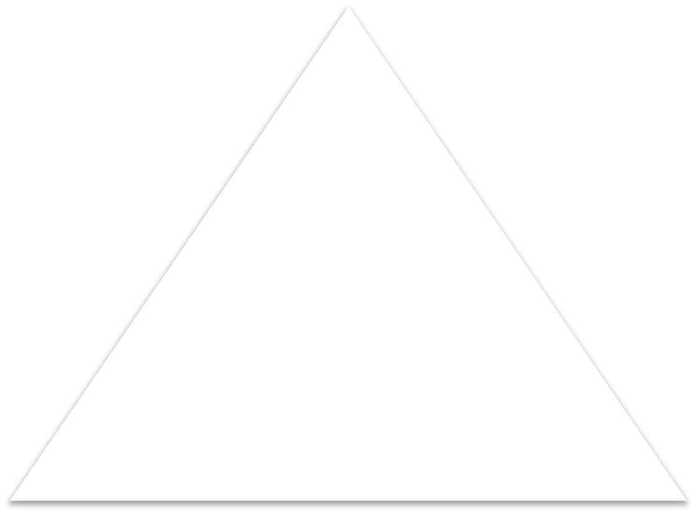






































Lecture Five( dispersion and prism )
A
₁
₂
3
₂
2
₁
2
1
2
1
1

Slide 6
Lecture Five( dispersion and prism )
The deviation angle 𝛿equal:
𝛿 = 𝜔₁ + 𝜔₂
𝑖₁ = 𝜔₁ + 𝑖 ;
𝜔₁ = 𝑖₁ − 𝑖
1
1
𝑖₂ = 𝜔₂ + 𝑖 ;
𝜔₂ = 𝑖₂ − 𝑖
2
2
𝛿 = (𝑖₁−𝑖 ) + ( 𝑖₂ − 𝑖 )
1 2
𝛿 = (𝑖₁ +𝑖₂) − (𝑖 + 𝑖 )
1 2
𝑤𝑕𝑒𝑛 1234 = 360°

Slide 7
Lecture Five( dispersion and prism )
𝛿 = 𝑖₁ + 𝑖₂ − 𝐴 −−−−− −(1)
The minimum angle of deviation
= The total angle of deviation
𝜕𝛿 ₌ 𝜕𝛿 ₌ ₀
𝜕𝑖₁ 𝜕𝑖₂
When 𝛿 = 𝛿_{𝑚𝑖𝑛} ;
Using snell’s on the first face prism:-
𝑛₁ sin 𝑖₁ = 𝑛₂ sin 𝑖 → sin 𝑖₁ = 𝑛₂ sin 𝑖
1 1
𝑖₁ = sin⁻¹ 𝑛₂ sin 𝑖 −−−−− −(2)
1

Slide 8
Lecture Five( dispersion and prism )
Using snell’s on the second of the face prism (glass –air):-
𝑛₂ sin 𝑖 = 𝑛₁ sin 𝑖₂ → sin 𝑖₂ = 𝑛₂ sin 𝑖 2 2
𝑖₂ = sin⁻¹ 𝑛₂ sin 𝑖
2
𝑖₂ = sin⁻¹ 𝑛₂ sin[𝐴 − 𝑖 ] −−−−− −(3)
1

Slide 9
Lecture Five( dispersion and prism )
𝛿 = sin⁻¹ 𝑛₂ sin 𝑖 + sin⁻¹ 𝑛₂ sin[𝐴 − 𝑖 ] − 𝐴
1 1
𝜕𝛿 ₌ 𝜕𝛿 ₌ ₀
A is constant and 𝛿 = 𝛿_{𝑚𝑖𝑛} ;
𝜕𝑖₁ 𝜕𝑖₂
𝜕𝛿
′ ′
₌ 𝑖cos₂𝑛 ₁ ₋ 𝑖−𝐴[cos₂𝑛 ₁] ₌ ₀
•
𝜕𝑖₁
1−𝑛² sin² 𝑖′ 1−𝑛² sin[𝐴−𝑖′ ]
2 1 2 1
𝑛₂ cos 𝑖′ 𝑛₂ cos[𝐴−𝑖′ ]
•
1
1
= 𝑡𝑕𝑖𝑠 𝑖𝑠 𝑡𝑟𝑢𝑒 𝑤𝑕𝑒𝑛 (𝑖
1
1−𝑛² sin² 𝑖′
1−𝑛² sin[𝐴−𝑖′ ]
2 1
2 1
= 𝐴 − 𝑖 )
1

Slide 10
Lecture Five( dispersion and prism )
Using the snell slaw again at first surface
𝑛₁ sin 𝑖₁ = 𝑛₂ sin 𝑖
sin
The refractive index of the prism is calculated by
1
𝛿_{𝑚𝑖𝑛}+ 𝐴
= 𝑛₂ sin ^{𝐴}
2 2
_{sin} 𝛿_{𝑚𝑖𝑛}+𝐴
•
For small angle less than 10 :-
sin
_{𝑛2=} 2
sin^{𝐴}
2
°
𝛿_{𝑚𝑖𝑛}+𝐴 𝛿_{𝑚𝑖𝑛}+𝐴
=
; sin ^{𝐴} = ^{𝐴}
2 2
2 2
𝛿_{𝑚𝑖𝑛}+𝐴
•
The minimum angle of deviation is given by figure below
_{𝑛2=} 2
→ 𝛿_{𝑚𝑖𝑛} = 𝐴(𝑛₂ − 1)
𝐴
2

Slide 11


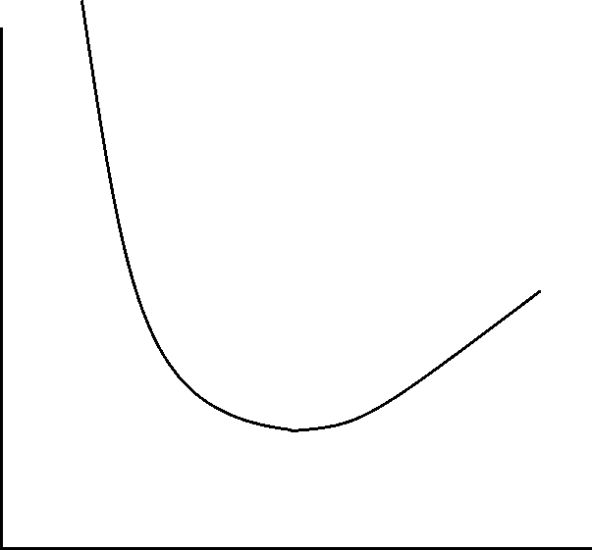






Lecture Five( dispersion and prism )
Angle of Deviation
Angle of Incident
₁
₂

Slide 12


Lecture Five( dispersion and prism )
A beam passing through an object like a prism or water drop is deflected twice: once entering, and again when exiting. The sum of these two deflections is called the deviation angle. The deviation angle in a prism depends upon:
(1)Refractive index of the prism: The refractive index depends on the material and the wavelength of the light. The larger the refractive index, the larger the deviation angle.
Angle of the prism: The larger the prism angle, the larger the deviation angle.
(3)Angle of incidence: The deviation angle depends on the angle that the beam enters the object, called angle of incidence. The deviation angle first decreases with increasing incidence angle, and then it increases. There is an angle of incidence at which the sum of the two deflections is a minimum. The deviation angle at this point is called the angle of minimum deviation. At the minimum deviation angle, the incidence and exit angles of the ray are identical. One of the factors that cause a rainbow is the bunching of light rays at the minimum deviation angle that is close to the rainbow angle.

Slide 13









Lecture Five( dispersion and prism )
Color Dispersion :-
It is well known to those who have studied elementary physics that refraction causes a separation of white light into its component colors. Thus, as is shown in Fig, the incident ray of white light gives rise to refracted rays of different colors (really a continuous spectrum) each of which has a different value of 𝜃′ . The value of n' must therefore vary with color.
White light
n=1
Red = C
Yellow=D Blue = F
F
C
D

Slide 14

Lecture Five( dispersion and prism )
The dispersive power is defined is a measure of the ability of a substance to disperse light, equal to the quotient of the difference in refractive indices of the substance for two representative wavelengths divided by the difference of the refractive index for an intermediate wavelength, and is defined by the equation:
_{𝑽 =} 𝒏_{𝑭}− 𝒏_{𝑪}
𝒏_{𝑫}−𝟏

Slide 15




Lecture Five( dispersion and prism )
Or in prism it’s defined as the ratio of angular dispersion to the deviation produced by mean color.

Slide 16

Lecture Five( dispersion and prism )
_{V =} 𝛿_{V}−𝛿_{𝑅 =} 𝛿_{V}−𝛿_{𝑅}
^{𝛿}𝑚𝑒𝑎𝑛
𝛿_{V} = 𝐴 𝑛_{V} − 1
𝛿_{R} = 𝐴 𝑛_{R} − 1
𝛿_{Y} = 𝐴 𝑛_{Y} − 1
𝛿_{𝑌}
𝑓𝑜𝑟 𝑣𝑖𝑜𝑙𝑒𝑡 𝑙𝑖𝑔𝑡𝑕
𝑓𝑜𝑟 𝑅𝑒𝑑 𝑙𝑖𝑔𝑡𝑕
𝑓𝑜𝑟 𝑌𝑒𝑙𝑙𝑜𝑤 𝑙𝑖𝑔𝑡𝑕
_{V =} 𝛿_{V}−𝛿_{𝑅 =} 𝛿_{V}−𝛿_{𝑅}
^{𝛿}𝑚𝑒𝑎𝑛
𝛿_{𝑌}
_{V =} 𝐴 𝑛_{V}−1 −𝐴 𝑛_{R}−1
𝐴 𝑛_{Y}−1

Slide 17
Lecture Five( dispersion and prism )
_{𝑽 =} 𝒏_{𝑭}− 𝒏_{𝑪}
𝒏_{𝑫}−𝟏
For White light:
𝛿_{𝑚𝑒𝑎𝑛} = 𝛿_{𝑌} = ^{𝛿𝑉+𝛿𝑅}
2
𝑽 = ^{𝛿V−𝛿𝑅} = 𝟐(^{𝛿V−𝛿𝑅})
𝛿_{𝑉}+𝛿_{𝑅} 2
𝛿_{𝑉}+𝛿_{𝑅}
The reciprocal of the dispersive power is called the dispersive index (w)
𝑤 =
𝒏_{𝑫}−𝟏
𝒏_{𝑭}− 𝒏_{𝑪}

